Slide 1



Annual Title I
Parent Meeting
LaRose
Community School
August 29, 2024
Staci Hendrix, Principal
Veronica Becton, Assistant Principal
Wanda Gillard-Phifer, PLC Coach

Slide 2

What is TITLE I?
Title I School-Wide Program
“Title 1” is the federal program that provides funding to local school districts to improve the academic achievement of disadvantaged students.
It is part of the Elementary and Secondary Education Act first passed in 1965.

Slide 3

LaRose Title I /AYP Status
LaRose Elementary is a Title I school.
Additional funds are provided to our school and determined by:
Student enrollment
Students needs
The number of students from low socio-economic backgrounds
Based on the state of Tennessee model, LaRose Elementary School is in CSI status (Comprehensive Support and Improvement)

Slide 4

Parent – Teacher Conferences
A conference can be scheduled anytime a parent feels there is a need.
September 5th (4:00 – 7:00)
February 13th (4:00 – 7:00)

Slide 5

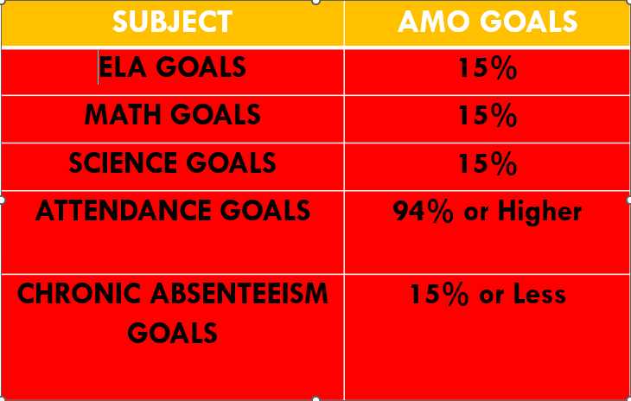
TnReady Baseline Year Results
Grades 3-5
(2023-2024)
Proficiency Levels Students are expected to meet (AMO)

Slide 6


Truancy
A student is considered truant when five (5) unexcused absences have been accumulated.
Absences need not be consecutive.
Under the “compulsory education” laws in Tennessee, children must regularly attend school from the time they are 6 years old until they turn 18. Except as otherwise provided by law, a child may be truant under the law who is less than six (6) years of age, provided that a child may be withdrawn six (6) weeks of initial enrollment without penalty. (SCS Policy 6006)
…this also includes 5 yr. olds (kindergartners) who have attended school for 6 weeks...

Slide 7

School Improvement Plan
A school improvement plan is a road map that sets out the changes a school needs to make to improve the level of student achievement and shows how and when these changes will be made. ...
As the plan is implemented, schools continue to gather data.

Slide 8

Reporting Student’s Progress
Report Cards (District report cards-4th week of each 9-week period)
Progress Reports
Phone calls/Notes
Social Media (Facebook, Instagram, and Twitter)
Class Dojo
Email
Blackboard

Slide 9
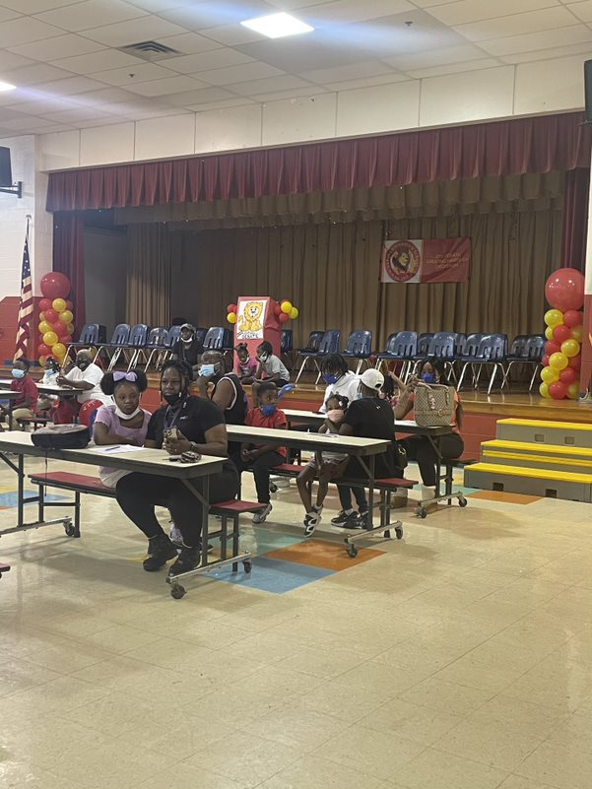

Parental Involvement Activities
Parental Involvement Opportunities
Volunteering in Classrooms
Field Trips (Fieldtrips)
Family Literacy Night
Family Math Night
Doughnuts for Dads
Muffins for Moms
Pastries with Parents
Parent Tech Night
Family Science Night
Proctors for TN Ready
Parent Resource Room

Slide 10

Family Engagement /Parental Involvement
Annual Meetings (TBA)
School-Parent Compacts
Partnership

Slide 11

School/ Parent Compact
School Responsibility
Student Agreement
Teacher Agreement
Parent Agreement

Slide 12

Parents Right to Know
All parents have the right to request:
A teacher’s professional qualifications, which includes state qualifications, licensure, certification, waivers
A teacher’s bachelors and/or graduate degree, fields of endorsement, previous teaching experience
A paraprofessional’s qualifications
An assurance that their child’s name, address, and telephone listing not be released to military recruiters

Slide 13

Assessment Dates
District Benchmark Dates:
FALL
August 12 – August 30, 2024
WINTER
January 8- January 31, 2025
SPRING
March 18 – April 4, 2025

Slide 14

WE ARE STRIVING TO SOAR
Parents are our partners!

Slide 15


